Slide 1
Movie Analysis Insights
Gatherings on movies and genres.
Notes:
© Copyright PresentationGO.com – Free Templates & Infographics for PowerPoint and Google Slides

Slide 2
INNITIAL SUMMARY
The range for the years was between 2010 to 2018.
The runtime mean was 92.92 minutes, the median was 90 minutes.
The mean of the average rating was 6.27, the median was 6.4.
The most popular genre was Drama with 41844 movies.
The year 2016 had the most number of movies with 12949 movies in total.
Notes:
© Copyright PresentationGO.com – Free Templates & Infographics for PowerPoint and Google Slides

Slide 3
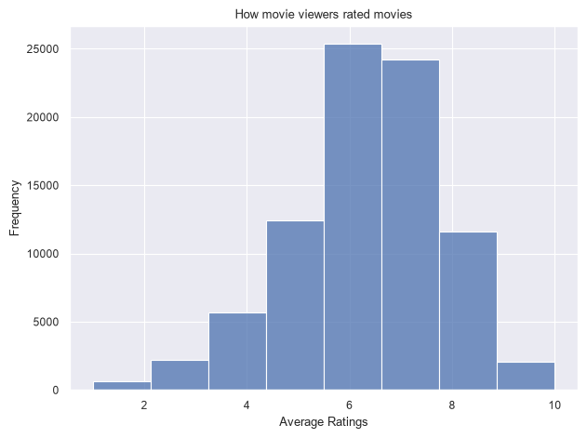
Relevant Trends
The frequency of ratings was skewed to the slightly to the right.
The graph shows that many movie viewers were rating the movies they watched a 6.
Very few movie watchers rated movies between a 9 and 10 while 0 to 2 was the only one lower than that
Notes:
© Copyright PresentationGO.com – Free Templates & Infographics for PowerPoint and Google Slides

Slide 4
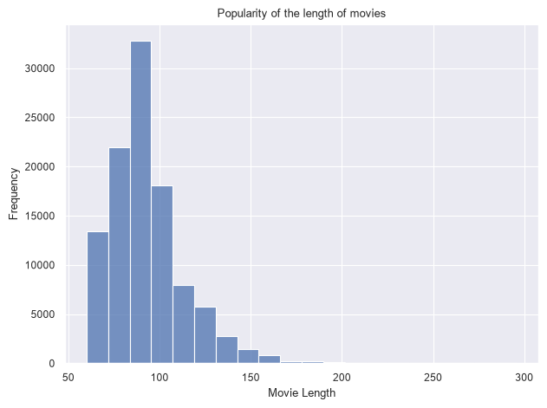
Relevant Trends
Many directors favoured their movies to be between 80 to 90 minutes.
Movies of around 300 movies were negligible.
Notes:
© Copyright PresentationGO.com – Free Templates & Infographics for PowerPoint and Google Slides

Slide 5
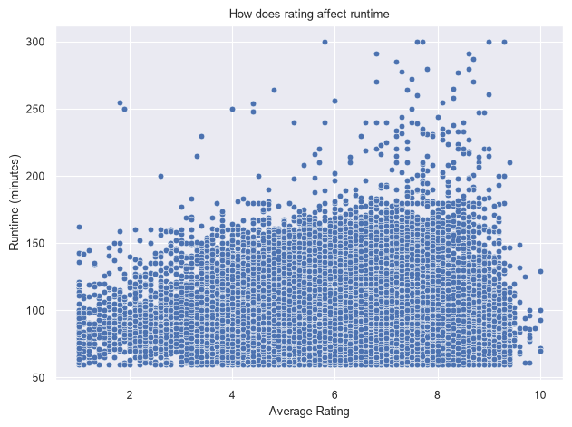
Business question
Runtime doesn’t affect rating as the points on the scatter plot show that the bulk of the movies do not go over 200minutes and their ratings are evenly spread out.
Notes:
© Copyright PresentationGO.com – Free Templates & Infographics for PowerPoint and Google Slides

Slide 6
Thank You!
Elvis Munyao
+254114446820
Notes:
© Copyright PresentationGO.com – Free Templates & Infographics for PowerPoint and Google Slides

